Slide 1
Attacking Lift

Slide 2
Outline
Our experiment is to determine that the relationship between the coefficient of lift and the angle of attack is linear for small angles whilst chaotic otherwise.

Slide 3
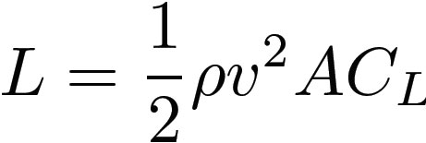
Introduction
Lift force important in aeroplane design which is an essential modern transport
Lift Equation
Flat bottomed aerofoil useful in recreational flight
Coefficient of lift is "a number that aerodynamicists use to model all of the complex dependencies of shape, inclination, and some flow conditions on lift" -NASA

Slide 4
Introduction – Implications
Angles measured between 0°-10° with 1° increments and 10°- 20° with 2.5° increments.
Selig flat-bottomed aerofoil.
- Provide useful data for when lift is prioritised over speed.
- Important for take off and landing procedures

Slide 5
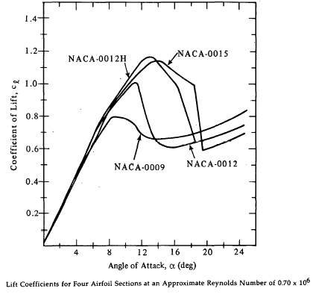
Introduction – Expectation
Linear at small angles (<10°) and chaotic at larger angles (>10°)
Previous study by Sheldahl, R
Take off and landing
Stalling conditions

Slide 6
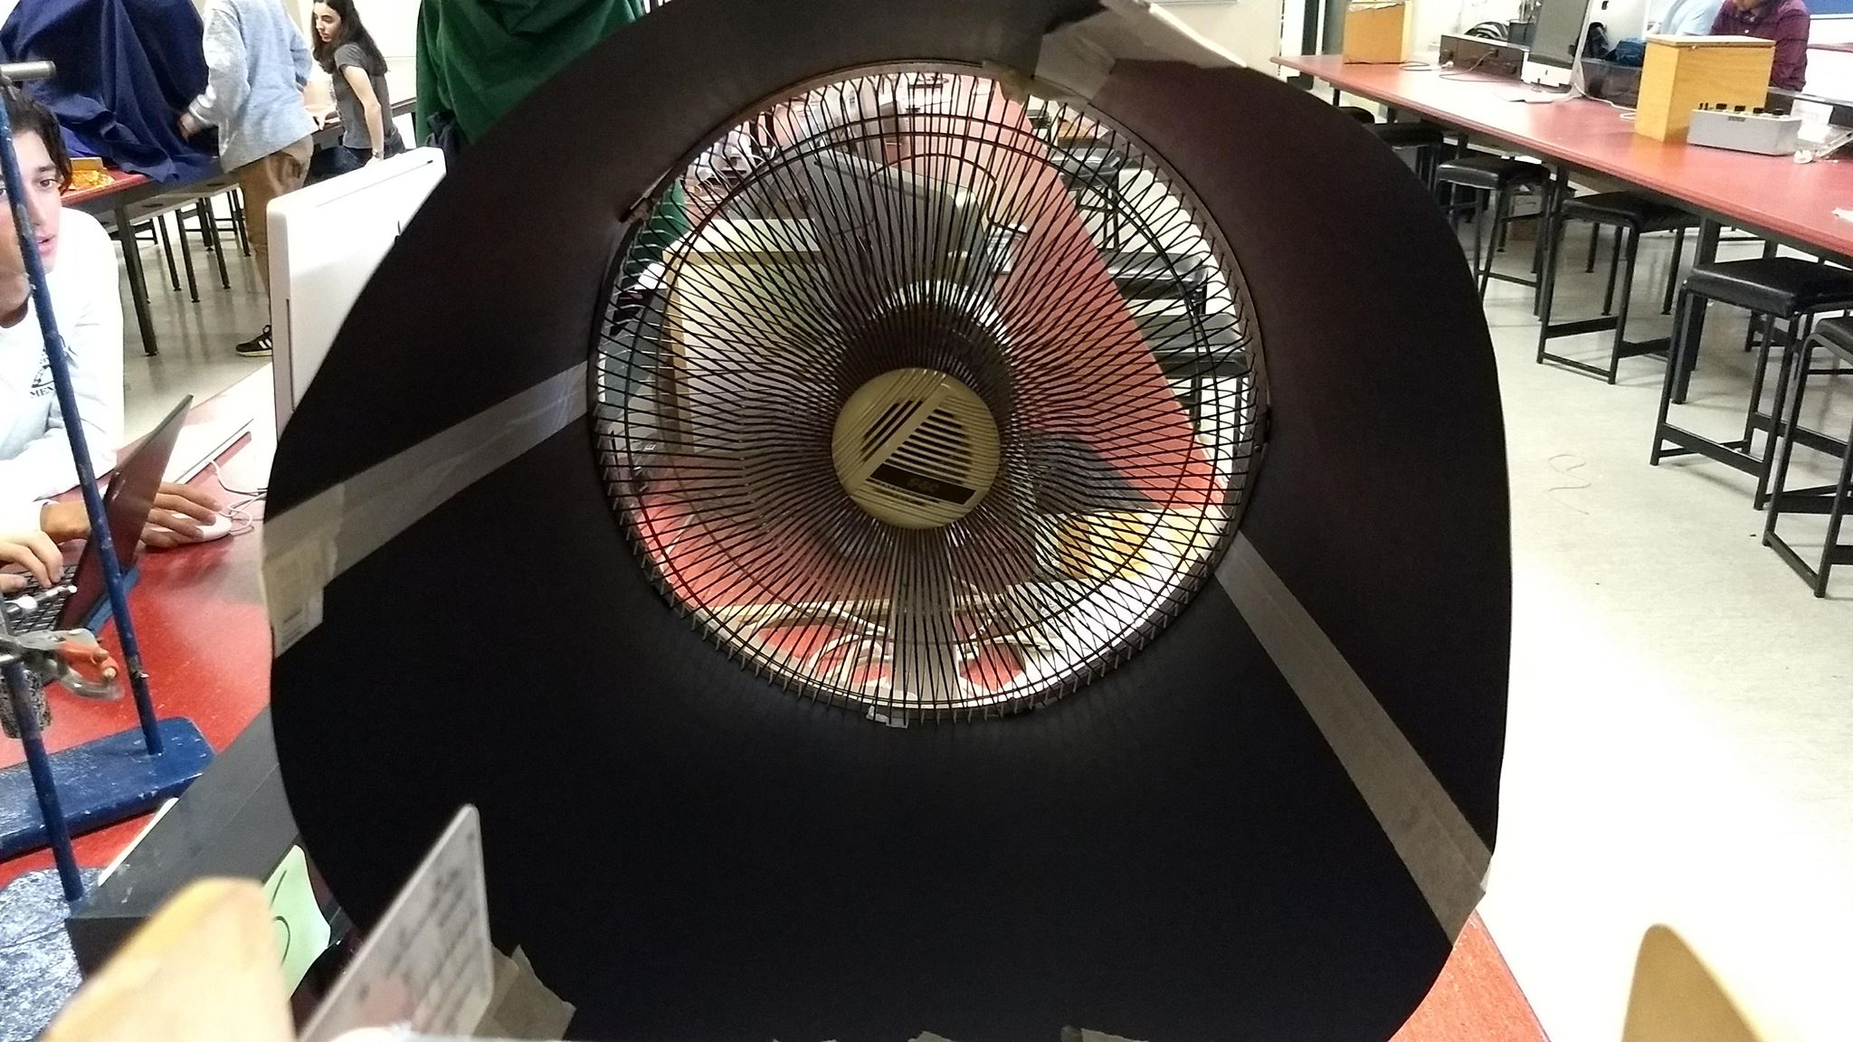
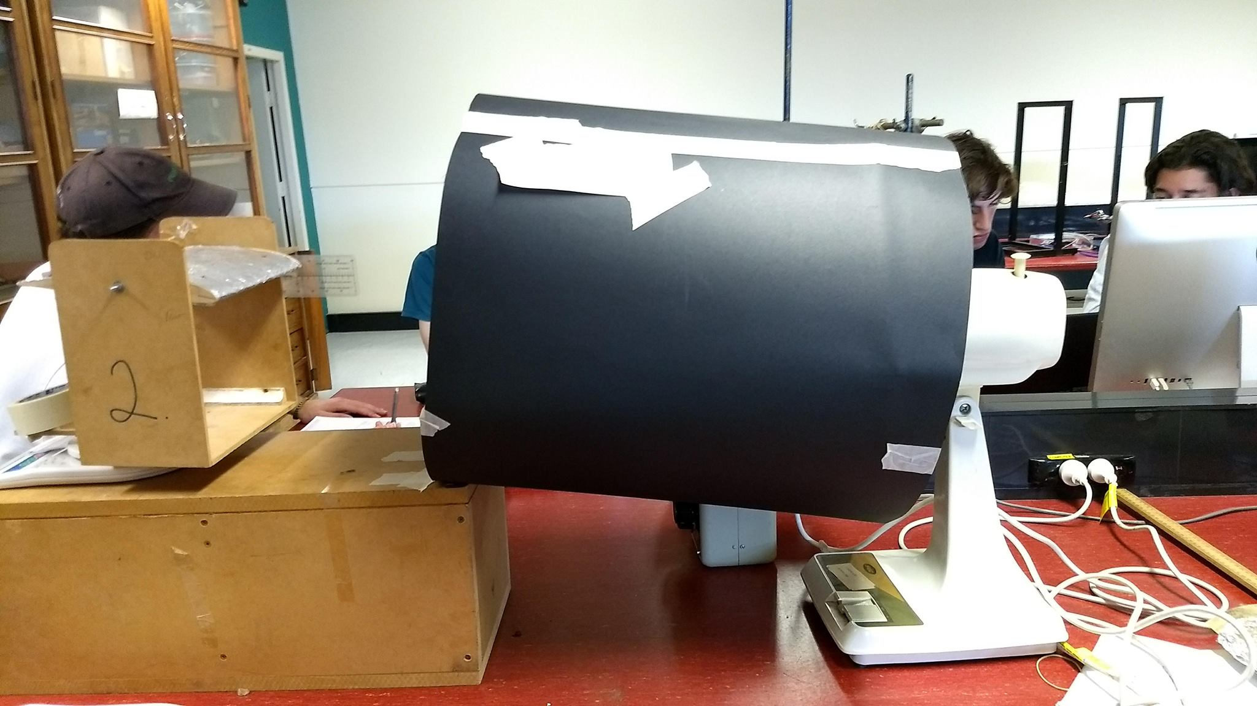
Setup

Slide 7
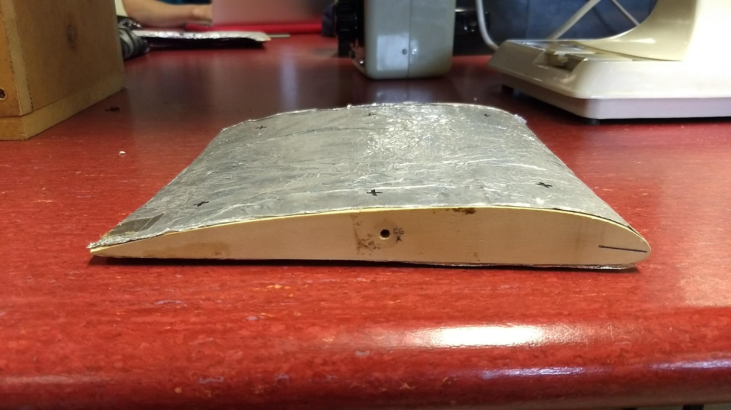
Setup

Slide 8
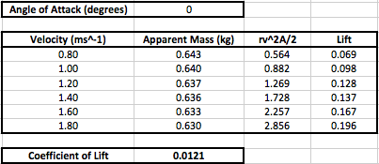
Results Table
Lift = (Initial Mass – Apparent Mass)g

Slide 9
Wing 1
Density: 37 kg/m^3
Cross-Sectional Area:
0.0477 m^2
Rest Mass: 0.65kg
Linear Trend line Equation:
Y = 0.026x + 0.042
Correlation Coefficient:
R^2 = 0.926

Slide 10
Wing 2
Density: 47 kg/m^3
Cross-Sectional Area:
0.0475 m^2
Rest Mass: 0.74kg
Linear Trend line Equation:
Y = 0.015x + 0.0394
Correlation Coefficient:
R^2 = 0.848

Slide 11
Discussion
The coefficient of lift increased linearly with angle of attack for both wings
For angles greater than 10°, the graph became chaotic and showed no linear relationship
For angles less than 10°, the linear trend did not have a gradient that agreed with the suggestion by the Glenn Research Centre.

Slide 12
Discussion – Source of Errors
Non – Laminar Flow
Not only aerofoil affecting flow
Anemometer measures incorrectly
Not a pure tunnel (open at one end)
Inconsistent Lift
Shaking of apparatus under high wind speed
Old fan makes wind speed inconsistent
Lift fluctuations may be within scales error band
Imprecise measurement of angle

Slide 13
Conclusion
Our experiment determined the linearity of the relationship between the coefficient of lift and the angle of attack for small angles, critical in take off procedures.
The experiment did not replicate the proposed relationship between the coefficient of lift and the angle of attack for small angles
The linear trend that exists in small angles of attack shows the consistent lift force present in take off and the chaotic behaviour afterwards indicates a stall.

